Slide 1
My Senior Project
Next
By: Jonah Watson

Slide 2
Table of Contents
Prev
Next
Overview
Calendar Control
Calendar Styles
Calendar Control Properties
Convert DateTime Objects to String Formats
FAQs

Slide 3
Overview
Prev
Next
This presentation goes over the finer points of the calendar control, a functionally rich web control capable of displaying one month at a time, allowing the user to select a single day, week, or month. Included in this presentation are details on the design styles for a calendar control, properties of a calendar control and how to convert the DateTime values in a calendar control to strings.

Slide 4
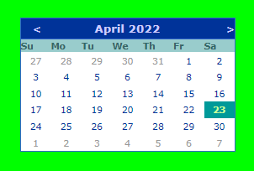
Calendar Control
Prev
Next

Slide 5
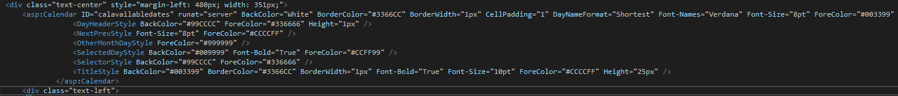
Calendar Control
Prev
Next
The calendar control displays a single month calendar that enables the user to select dates and move to the next or previous month.
See the Image below for how to set the calendar control’s properties
Can only select one day, week or month at a time

Slide 6
Calendar Styles
Prev
Next
DayHeaderStyle – Specifies the style for the section that displays the days of the week
DayStyle – Specifies the style for the dates in the displayed month
NextPrevStyle – Specifies the style for the navigation controls in the title section
OtherMonthDayStyle – Specifies the style for the dates that are not in the currently displayed month
SelectedDayStyle – Specifies the style for the selected dates on the calendar
SelectorStyle – Specifies the style for the week and month date-section column
TitleStyle – Specifies the style for the title selection
TodayDayStyle – Specifies the style for today’s date
WeekendDayStyle – Specifies the style for the weekend dates

Slide 7
Calendar Control Properties
Prev
Next
BackColor – Gets or sets the background color of the web server control
ForeColor – Gets or sets the color of the font in the web server control
Height – Gets or sets the height of the web server control
Font-Names – Sets the style of the font in the web server control
Font-Size – Sets the size of the font in the Calendar Control
Font-Bold – Makes the font in the Calendar bold depending on if the user enters “True” or “False”
BorderColor – Gets or sets the border color of the web server control
BorderWidth – Gets or sets the border width of the web server control
CellPadding – Gets or sets the amount of space between the contents of a cell and the cell’s border
DayNameFormat – Gets or sets the name format for the days of the week

Slide 8
Convert DateTime Objects to String Format
Prev
Next
.ToLongDateString – Converts the value of the current DateTime object to its equivalent long date string representation.
.ToLongTimeString – Converts the value of the current DateTime object to its equivalent long time string representation.
.ToShortDateString – Converts the value of the current DateTime object to its equivalent short date string representation.
.ToShortTimeString – Converts the value of the current DateTime object to its equivalent short time string representation.
The DateTime value, “Thursday, June 3, 2022, 2:25:00 PM” would appear in the following string conversion formats as:
.ToLongDateString – “Thursday, June 3, 2022”
.ToLongTimeString – “2:25:00 PM”
.ToShortDateString – “6/3/2022”
.ToShortTimeString – “2:25 PM”

Slide 9
FAQs
Prev
End Show
Can you select multiple dates at once in a calendar control? In ASP.NET, you cannot. In other programming languages, calendar controls have a MultiSelectedDates property that can be set to “True” which will allow the user to select more than one date.
Can you select a time with a calendar control in ASP.NET? No. ASP.NET automatically assigns the time of a DateTime value selected from a calendar to “12:00:00 AM”. In order to change that time, you must use the “AddHours”, “AddMinutes”, and “AddSeconds” methods.
Is there a way to give a DateTime object the value of the current date and time? Yes. The ”Now” property of the DateTime data type assigns the value of the object the current date and time. Additionally, though it does not affect the time, the “Today” property assigns the date of a DateTime object, the current date.
Is there a way to tell whether one DateTime value is earlier than, the same as, or later than another DateTime value? Yes, the “CompareTo” method allows you the enter two different DateTime values and then display a message stating whether they are the same or one is earlier than or later than the other.
Is there a way to get the value of the selected date in a calendar control? Yes, the “SelectedDate” property of the calendar control gets or sets the value of the selected date.

